Slide 1
From Developer to Tester Boise Code Camp 2015
By Joel Robinson
joelhrobinson@gmail.com
https://www.linkedin.com/profile/view?id=4716557

Slide 2
Classic Testing Mistakes by Brian Marick ©1997
Not finding IMPORTANT bugs Testing TOO LITTLE
Fuzzy or no testing goals Testing TOO LATE
Failing to identify risk areas Testing WRONG areas
Sticking with a bad plan Skipping test reviews
Not believing historical data Skipping Usability
Underestimating testing time Skipping installation tests
Underestimating support costs Skipping documentation
Relying on untrained testers Skipping irrelevant oddities
Relying on automated tests Poor bug reporting

Slide 3
Joel’s Developer Story
CS major Assembly/Fortran/Cobol/PLM
Assembly language 8080 Microprocessor
Bought HW from Bill Gates in Albuquerque
Los Alamos Lab experiments Assembler/ Fortran
FL Defense & Utilities Assembler/Fortran/C
Test lead small group, Fortran, MBA
Never seen a tester; test plan; or detailed spec.
Sure, why not! How hard can it be?

Slide 4
Joel Tester Story
DOD-STD-2167A "Defense Systems Software Development“ 50 pages
Software Standards for contractors
All Waterfall: Design everything, Code then Test
Reports, Progress documents, schedules
Metrics: Code coverage, % Complete
Defect Tracking tools, Bug Fix reports
Must be within 80% confidence
Deliverables, milestones, metrics, & Earned Value
Responsible for quality of code written by many others

Slide 5
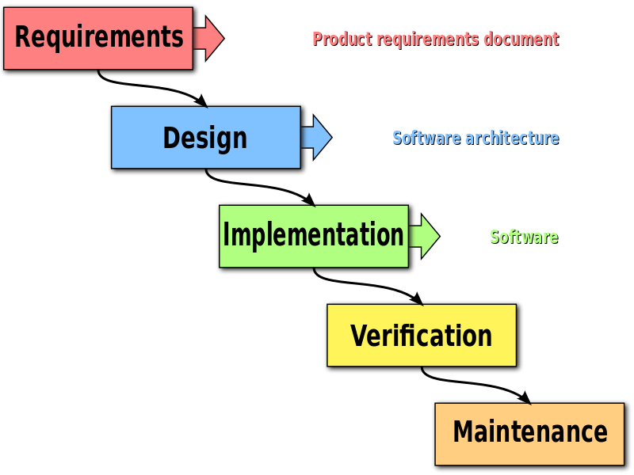
Waterfall Model"
by Peter Kemp / Paul Smith - Adapted from Paul Smith's work at Wikipedia.

Slide 6
Military officers barking out commands, yelling why project was late.
Multi-million dollar rockets to launch
More staff? No, + need high clearances
Work late? No, very secure facility closes
Frustration grew, I went to ‘other ventures’
Why did I fail?

Slide 7
Software Test is a Different Profession
I didn’t know jack about testing. My 1st attempt failed. But I resolved to learn more.
Why did I fail?
The next guy took my job -- finished testing, met the schedules, and rockets launched.
He knew 2167A spec, work environment, and test methodology. He was a test engineer.

Slide 8
Quick lesson in testing orbital telemetry: White Box vs. Black Box Testing
Rocket
Land Radar
Optic camera
Ship Radar
Azores
Courses #1-3
Courses #2-4
Courses #4-6
CRT
DETONATE

Slide 9
Why become a test engineer?
More customer centric
More variety of tasks
Somewhat less technical (different)
Less Stress
Better hours
Less micro-management

Slide 10
What makes a good test engineer?
Like to make things or like to break things?
Sheepdog desire to protect customers?
Understand project from customer perspective?
Desire for quality, attention to detail?
Tact & diplomacy?
Able to communicate high tech & low tech?
Can you evaluate risk? Able to foresee problems?
Like finding missing pieces of puzzle?
Ask yourself, what could possibly go wrong?

Slide 11
Downsides: SW Test vs. Development
Lower pay $5-$15K less same experience
Lower prestige, “…anyone can test”
Fewer job opportunities
Small companies have developers do all testing
Fewer advancement opportunities
Lower ratio of test engineers to developers
One QA lead but many software leads
Lower visibility to management
Manager probably came from dev. Not test.

Slide 12
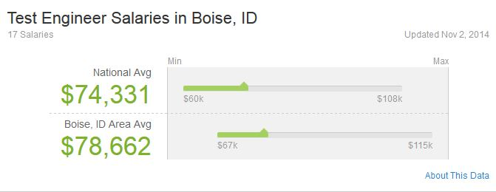
Not gonna happen from www.Glassdoor.com

Slide 13
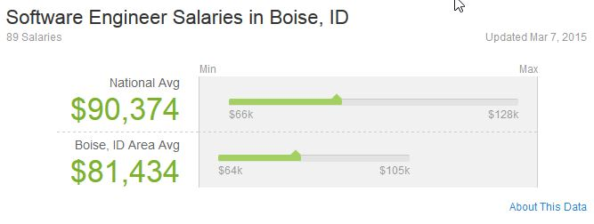
Glassdoor.com

Slide 14
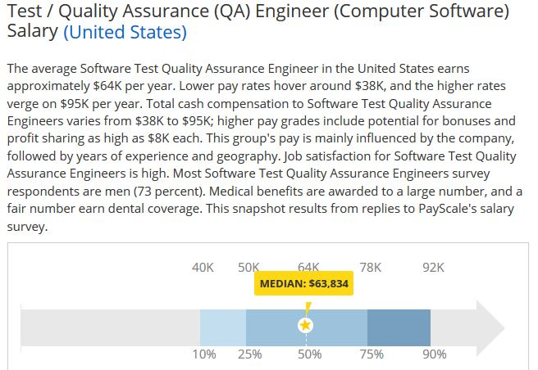
This is still too high www.payscale.com

Slide 15
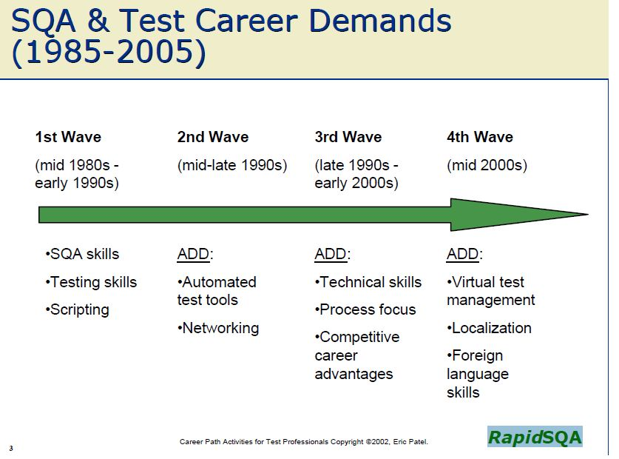
Past predictions www.rapidSQA.com

Slide 16
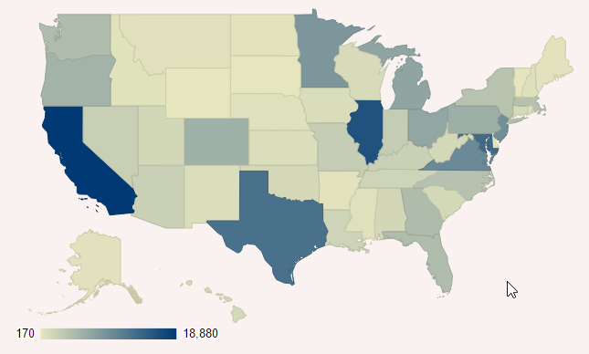
And you may be wise to move. Idaho has 550 QA engineers, California 18,800, Oregon 5580 Washington has 4530 www.sokanu.com US Dept Labor

Slide 17
Why give up SW Development?
Burned out on coding, fed up with projects
Bringing home work, 24/7 availability
Projects cancelled, code tossed, changed requirements & standards, maintaining & rewriting old spaghetti code
Don’t want project management
Symptom: “I can’t get myself to sit down and start coding.”

Slide 18
More Development Pitfalls
It’s easy to fall behind technically
Assembler, Fortran, Cobol, C, VB, C++,
C#, Java, JavaScript, PHP, Python, SQL, Ruby, Perl, .NET, “R”, Swift (Mac), Hadoop)
Every year, CodeEval publishes data on the "Most Popular Coding Languages" based on hundreds of thousands of data points collected by processing over 600,000+ coding tests and inputs by over 2,000+ employers.
http://blog.codeeval.com

Slide 19
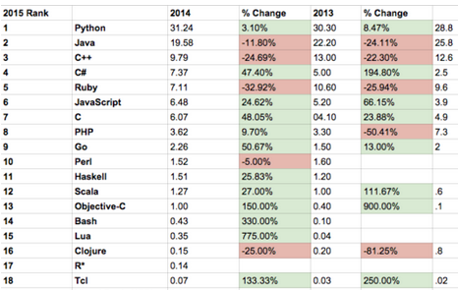

Slide 20
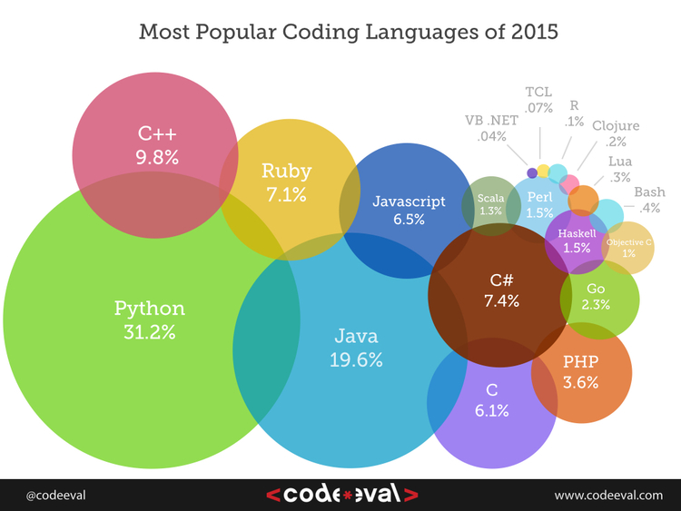

Slide 21
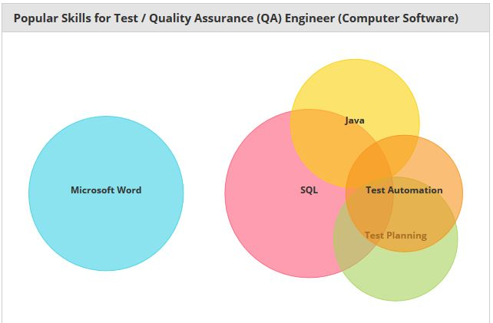
SW Skills used in Software test professionals www.Payscale.com

Slide 22
Initial Skill Sets
Soft skills
Quality- Driven
Analytical
Attention to detail
Communications
Self Starter proactive
Documentation
Get along with people
Think outside the box
Technical skills
Scripting & Language
Software Metrics
Build & Deploy
Defect Tracking tool
Multiple platforms
SQL / DB
Software Life Cycles
Agile / Scrum / Kanban

Slide 23
Advancement Skill Sets
Management
Metrics
Scheduling
Planning
Forecasting
Communications
Reporting
QA Environments
Customer relations
Technical
Automation
Load Testing
Build / Release
Scrum Master
Tool Maker / keeper
Risk Analysis
Knowledge Domain Specialist

Slide 27
Lead Test Engineer
Lead QA Engineer
Sr. Test Engineer
Sr. QA Engineer
Automation Engineer
Sr. Automation Engineer
Systems Analyst
UI Engineer
Build / Deploy Engineer
Software Programmer
Sr. SW Programmer
SW Project Manager
IT Consultant
QA Manager
QA Director
Cust. Support Manager
Product Manager

Slide 28
QA vs. QC http://www.dialog.com.au/
Quality Assurance
QA is the process of managing & improving quality
Establish the processes, activities, and standards that deliver the expected level of quality output
PREVENTION
Prevent defects from entering into the solution (control risk)
Quality Control
QC is the process of verifying the quality of the output
Measure the processes, activities and output for adherence to predefined standards and goals
REACTIVE
Find, measure, and monitor defects in the solution (feedback)

Slide 30
SW Test Engineer
Test Engineering Bridges QA & QC
Not manual repetitive regression testing
More human oriented – exploratory testing
Can be HW, SW, or FW (embedded)
Specializes in some aspect:
Test automation, load testing, localization,
Enviromental, Stress testing, life cycle,
Examples: Micron memory chips; HP printers
USB devices, mobile devices
https://en.wikipedia.org/wiki/Test_engineer
http://googletesting.blogspot.com/

Slide 32

# faces?

Slide 33

# faces

Slide 34

# figures?

Slide 35

# people?

Slide 36
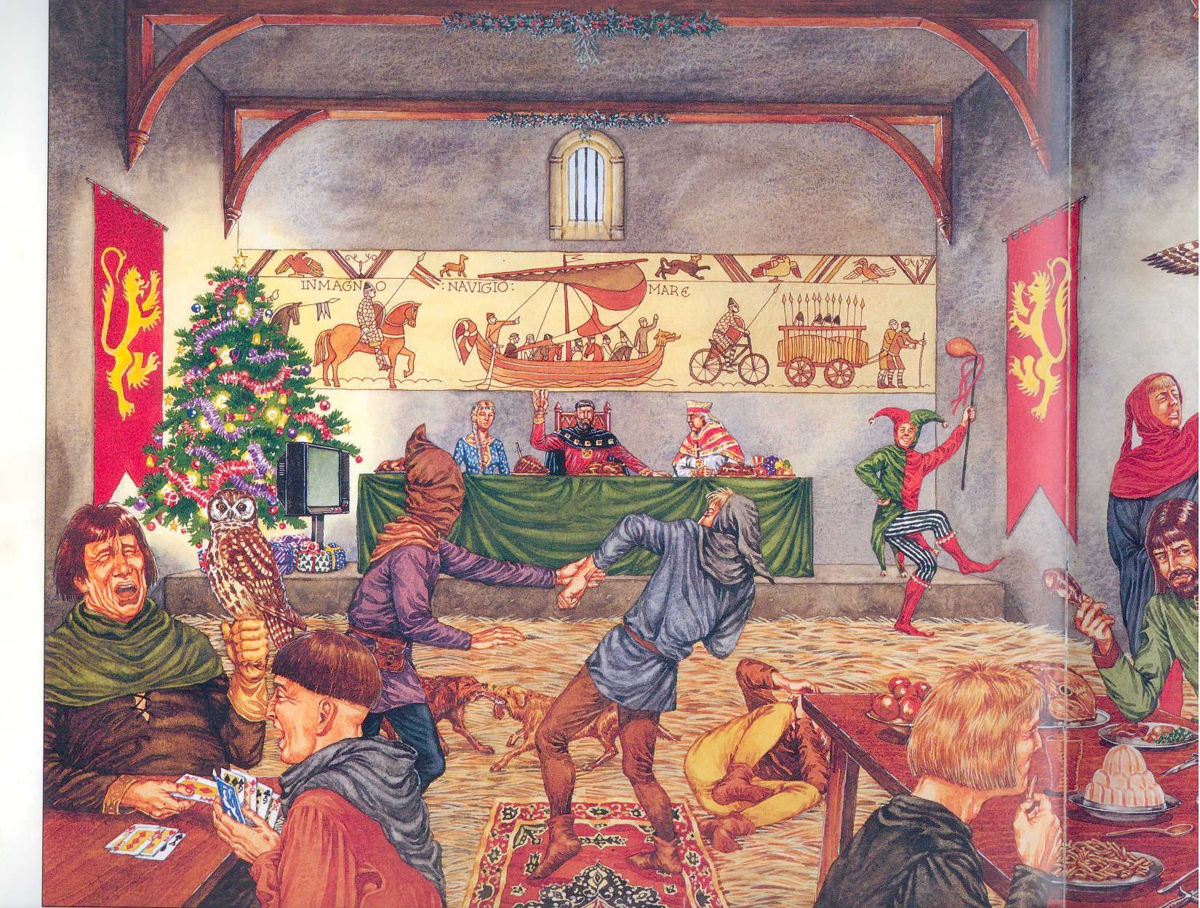

Slide 37
Christmas 1066 Inconsistencies
Playing cards not invented yet
Christmas tree, lights & gifts upper left
TV not invented yet upper left corner
Floor rugs were not in use
Falcons, not owls were pets
Jell-O dessert on table
French fries on table
Drinking glass on table
Bicycle in tapestry

Slide 38
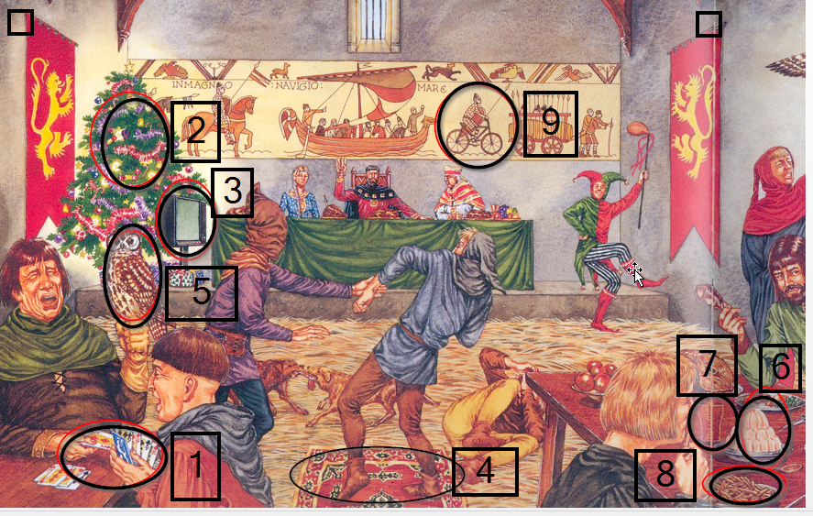

Slide 39

Certified Software Tester (Engineer)
Certification demonstrates a professional level of understanding of software testing principles and practices.
Acquiring the designation of Certified Software Tester (CSTE) indicates a professional level of competence in the principles and practices of software testing in the IT profession.
Training, continuing education, proof of professional competency, resource materials.
www.softwarecertifications.org

Slide 40
Benefits of Certification
Internal benefits, rarely on job descriptions
Increased self confidence
Increased employer confidence
Learn complex skills outside day-day activities
Requires improvement in skills & knowledge
Continual improvement to re-certify
Independent assessment of competency
Develops lifetime learning habits

Slide 41
Professional organizations & Certifications
www.QAI.com Quality Assurance Institute
www.SoftwareCertifications.com Certification
www.meetup.com User groups Boise on test
www.kickstand.org Startup entrepreneurs
www.startupgrind.com/boise/ Startup Support
http://boise.sqlpass.org/ Boise SQL Users Group

Slide 42
Professional Resources
www.QAI.com Quality Assurance Institute
www.Stickyminds.com magazine
www.SoftwareCertifications.com
www.softwareqatest.com
www.Youtube.com
www.SoftwareTestingStandard.org IEEE
Download White papers from vendors
Subscribe to blogs, especially popular authors
Join LinkedIn and meet people
joelhrobinson@gmail.com
https://www.linkedin.com/profile/view?id=4716557

Slide 43




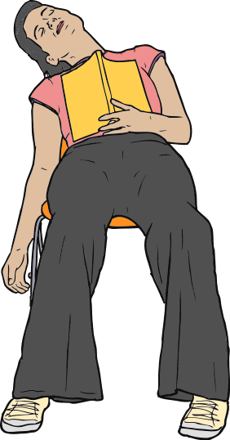

How people see you, it’s up to you.

Slide 44
Questions?
Join me on LinkedIn.com
joelhrobinson@gmail.com
https://www.linkedin.com/profile/view?id=4716557

